Slide 1
Organising space: trees & LoD
DAY 07 OF 16 · 3D & 6DOF STREAMING
How to find neighbours among millions of points in microseconds, and how the same idea gives us Levels of Detail for streaming.
Why structure?
k-d tree
Octree
LoD pyramid
Streaming coarse→fine
Book: Ch. 4, 17 · Code: day07_spatial_structures_lod/
Notes:
This session uses the book’s Chapter 4 section on k-d trees, octrees and BVH, and the condensed octree code in Chapter 17. It is the bridge between 3D data science and streaming: the octree is the structure behind Potree, Cesium 3D Tiles and MPEG G-PCC.

Slide 2
Most of space is empty. Good data structures spend nothing on emptiness.
THE BIG IDEA
At level 10 of our octree, only 0.001% of the possible cells hold any point.
Day 07 · k-d trees, octrees, LoD
2
Notes:
Read the number from the lab: of the 8 to the power 10 cells at level 10, only about 14,000 hold points. Ask students to imagine a voxel grid at that resolution: over a billion cells, almost all empty. Trees solve this by only creating nodes where data exists.

Slide 3
k-d tree: split space in half, again and again
BOOK CH. 4
How
Gives
Lab result
Split the points by the median along x, then y, then z, recursively.
Nearest-neighbour and radius queries in about log N steps instead of N.
200 queries on 283k points: 449 ms brute force vs 1.3 ms with a k-d tree (335× faster).
01
02
03
Day 07 · k-d trees, octrees, LoD
3
Notes:
Explain with a 2D sketch: split the points by a vertical line at the median x, then each half by a horizontal line at its median y, and so on. To find a neighbour, you descend to the leaf and only check nearby cells. The book compares build times and notes k-d trees are quicker to build than octrees. Neighbour queries are everywhere: normals, outlier removal, features, ICP, clustering. They all use a k-d tree internally.

Slide 4
Octree: split a cube into 8, again and again
BOOK CH. 4 & 17
How
Gives
Why for streaming
Each node is a cube; an occupied cube gets up to 8 children (octants).
A regular hierarchy: level L has cells of size S / 2ᴸ.
Each level is a complete, coarser copy of the scene. Download levels in order = coarse to fine.
01
02
03
Day 07 · k-d trees, octrees, LoD
4
Notes:
The book explains the name: oct plus tree. Unlike k-d trees, octrees always divide space into 8 equal octants, which suits multi-resolution work. The book’s Chapter 17 says octrees are incredibly powerful for large-scale 3D visualisation and describes using one to dynamically load a city-scale model. Our lab builds an octree from scratch in about 20 lines, the same structure as the book’s condensed OctreeNode class.

Slide 5
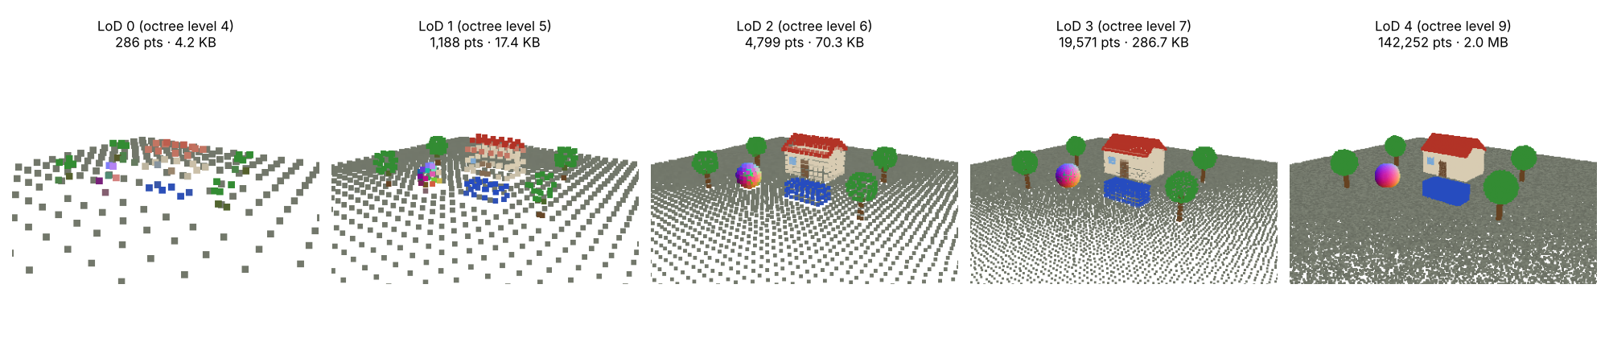
An LoD pyramid from octree levels
LAB PREVIEW
LoD 0: 286 points, 4 KB. LoD 4: 142k points, 2 MB. Each level keeps one point per occupied cell.
Day 07 · k-d trees, octrees, LoD
5
Notes:
Read the numbers: 4 KB, 17 KB, 70 KB, 287 KB, 2 MB. The first level is tiny and loads instantly, yet it already shows the layout of the scene. Each next level is about 4 times bigger (a surface fills about 4 of the 8 child cells). This is how Potree and 3D Tiles viewers behave: you see a blurry version immediately, then it sharpens where you look. Notice the renderer draws coarse levels with bigger points to fill gaps; we use that trick again on Days 14 and 15.

Slide 6
The octree is a streaming plan
LOOKING AHEAD
Send coarse first
Refine where it matters
Standards
A preview arrives in milliseconds.
Potree, Cesium 3D Tiles and MPEG G-PCC all build on this hierarchy.
Only children of nodes the viewer sees and is close to.
01
02
03
Day 07 · k-d trees, octrees, LoD
6
Notes:
Connect explicitly to Days 13 to 15. G-PCC encodes geometry as octree occupancy bytes, which we implement on Day 13. Viewport-adaptive streaming (Day 14) picks which nodes to refine based on the viewer’s pose. Our Day 15 server uses tiles plus LoDs, a simplified version of 3D Tiles.

Slide 7
Time a k-d tree, build an octree, make LoDs
HANDS-ON LAB · COPY, RUN, LOOK
RUN IT
cd day07_spatial_structures_lod
python kdtree_octree_lod.py
→ Compare brute-force and k-d tree timings.
→ Read the occupancy table per octree level.
→ Open lod0.ply … lod4.ply in a viewer.
Day 07 · k-d trees, octrees, LoD
7
Notes:
Run and read. Exercises: double the points and see how timings scale; change the LoD representative from centroid to first point; estimate download time of each LoD over 4G. Lab L4 question 1 asks for a box query on this octree. 30 minutes.

Slide 8
Three things to remember
1
k-d trees make neighbour search ~log N: the engine under most point algorithms.
2
Octrees cut space into 8 recursively and skip empty space.
3
Each octree level is a Level of Detail: the backbone of 3D streaming.
BEFORE NEXT SESSION
Finish mini-project P1 (due Day 8). Start Lab L4. Next: cleaning noisy scans and aligning them.
Day 07 · k-d trees, octrees, LoD
8
Notes:
Recap. P1 is due at the start of Day 8. Day 8 covers preprocessing and registration; ICP will find a 6DoF pose automatically.

